Slide 1
Serverless in Seattle
Reducing Server Costs with AWS Lambda
August 9, 2018

Slide 2
Initial Observations
Our NextGen web servers (or Hydra-Graph servers) run in a Node.js environment. Node.js is an excellent platform for delivering our customers' websites in terms of I/O (Input/Output), flexibility, and resiliency. In our experience, one of the most computationally complex activities required of our Hydra servers is that of LESS compilation. LESS is a backwards-compatible language extension for CSS, the language we use to style our web pages. LESS offers a variety of benefits to designers, developers, and engineers and is an important component of our websites. Historically, LESS compilation was handled on Hydra servers. One of the drawbacks to performing this compilation on those servers is that a heavy compilation cycle (for example, during twice-weekly deployments of new software) can significantly reduce our I/O performance. In an effort to increase the performance of our Hydra servers, we've been working to move compilation off of the Hydra servers and into dedicated servers used exclusively for LESS compilation.

Slide 3
The Problem
Currently, we have provisioned servers to perform LESS compilation in our Las Vegas data center. These servers run 24/7 and are quite costly, especially considering that they are used for specific requests at irregular intervals. Our team decided that this was an excellent opportunity to provide some cost savings.

Slide 4
Proposed Solution
What if we could compile LESS without spinning up a bunch of under utilized servers?
Have you heard of AWS Lambda?
Lambda is a "pay as you go" compute service for executing stateless micro service code. Lambda scales instantly to meet demand, running parallel instances per request. Once the monthly “free tier” resources have been consumed, additional requests are billed according to the amount of memory used, the number of requests and the execution duration (rounded up to the nearest 100ms interval).
Code running on lambda must conform to a number of resource constraints. For example, the memory allocation range is 128-3008MB with 64MB increments in between, disk capacity is 512MB and maximum execution duration per request is 300 seconds. Based on these constraints, our LESS compilation code appeared to be a good fit for the serverless platform.

Slide 5


Identical Performance
No visual differences, no performance differences.
AWS Lambda
Style Service
5.5 sec
CSS Compile
5.5 sec
CSS Compile
Place your screenshot in the screen frame

Slide 6
1/10th the Cost – Nearly Free
Calculated Monthly Cost.
AWS Lambda Costs
Hosted
Style Servers
$16
Monthly
$1600
Monthly
Place your screenshot in the screen frame

Slide 7
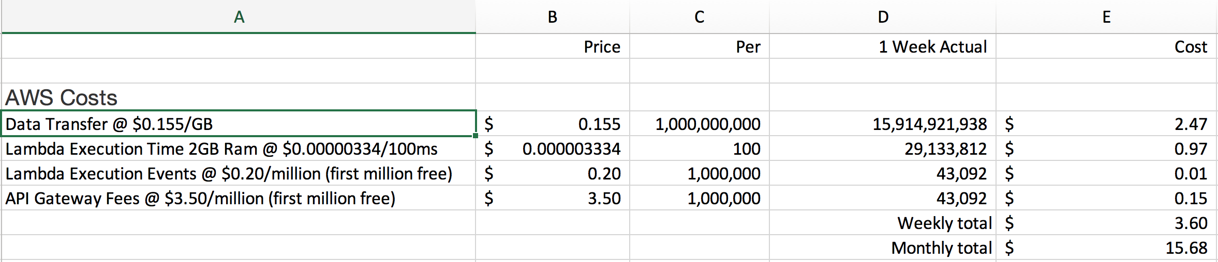

Slide 8

Conclusion
AWS Lambda Recommended
Based on our findings, we believe AWS Lambda is a viable solution for reducing server costs by migrating LESS compilation from our existing servers to AWS Lambda.
Request
Webpage
Hydra-Graph
Request
Compiled CSS
Route to
Lambda Function
…
End User
Hydra-Graph Service
Amazon API Gateway
AWS Lambda Function

Slide 9
Conclusion
Additional Use Cases & Benefits
01
Offload services provisioned for peak traffic to AWS Lambda functions.
02
Free hosting for low-traffic internal tools.
Provisioned to Pay-Per-Use
Provisioned
Servers
Serversless

Slide 10
Thank you!
Questions?

